Slide 1

Fake News Classifier
Mayank Kumar
This Photo by Unknown Author is licensed under CC BY-NC-ND

Slide 2


Use Case
The authenticity of Information has become a longstanding issue affecting businesses and society, both for printed and digital media. On social networks, the reach and effects of information spread occur at such a fast pace and so amplified that distorted, inaccurate, or false information acquires a tremendous potential to cause real-world impacts, within minutes, for millions of users. Recently, several public concerns about this problem and some approaches to mitigate the problem were expressed.
In this project, using various model we must build a model which able to predict whether the news is real or fake.

Slide 3
Approach and Life Cycle

Slide 4


Slide 5

Data Description
There are 6 columns in the dataset provided to you. The description of each of the column is given below:
“id”: Unique id of each news article
“headline”: It is the title of the news.
“news”: It contains the full text of the news article
“Unnamed:0”: It is a serial number
“written_by”: It represents the author of the news article
“label”: It tells whether the news is fake (1) or not fake (0).

Slide 6

Data Cleaning
For Data Cleaning, there are 2 features in the dataset “unnamed” and “id” which are not playing an important role for the model building, so I removed them from the dataset.
Also, while doing text pre-processing, I used TFIDF vectorizer and count vectorizer, in which I used most important 5000 features from the dataset.
While using word embedding, every news of a row does not follow same length so, I added padding of zero sequence at prefix side to match each sentence length.

Slide 7
Creating Model
For solving his project I used various model followed by Naïve Bayes, LSTM.
For text preprocessing I used TFIDF and count vectorizer and used both and check the metrics.
Also used hyperparameter tuning and calculate the score and select the best model from all.

Slide 8
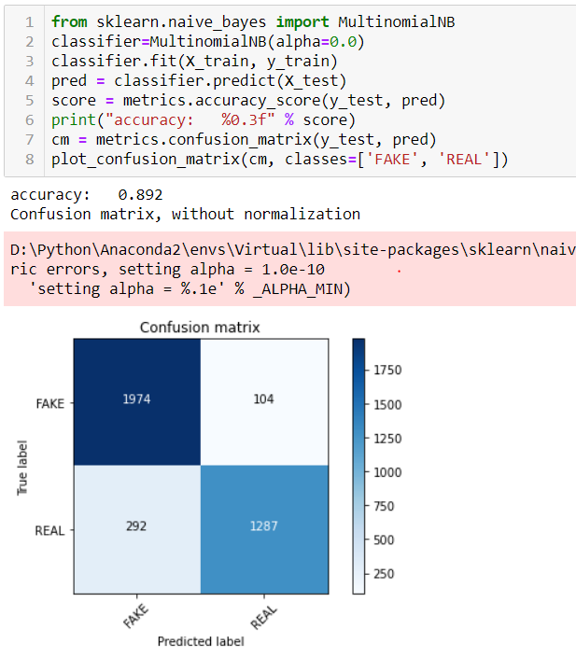
Metrics : Accuracy, Confusion Matrix
Naïve Bayes with hyperparameter tuning providing the best result among all.
For text preprocessing TFIDF providing the best result then count vectorizer.
As the False Positive is very less in this case as compared to others

Slide 9
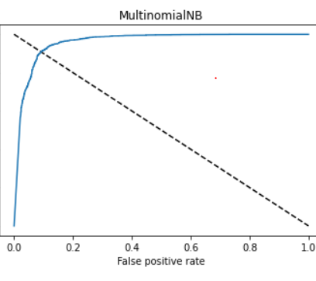
Roc Curve
Most of area is lying under the curve and providing the high true positive rate approx. 90% which is good sign of better prediction

Slide 10
Key Findings and Conclusions of the Study
There are various aspect of the dataset and observation from my point of view:
There are more than 60% news that are real.
Most of the real news are containing words followed by election, president etc.
Removing the column that are unnamed and id does not impact the model training.
Also, using tfidf vectorizer along with hyper parameter tuning reduce the false positive error.
Using the roc_auc_curve most of the region fall under the curve and accuracy is near to 90%.
From multiple model i.e. Naïve Bayes using both tfidf and count vectorizer and LSTM, Naïve Bayes with tfidf suit well for the data and have better performance as compared to others

Slide 11


Thanks

